Slide 1

Pipeline de deploy
Utilizando aplicação ASP.NET Core com VSTS
Jaqueline Ramos | ESX

Slide 2

Olá galera!
Prazer, Jaqueline Ramos
Consultora DevOps na ESX
MCP | MS Azure
Blog: jaquelinecramos.com
Facebook: Jaqueline.ramos17
Linkedin: linkedin.in/jaqueline-ramos-bab8a432
Github: github.com/jaquelinecramos

Slide 3
Agenda
Code
Build
Release
Test
Monitoring

Slide 4

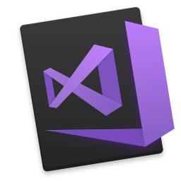

Code
Git
Visual Studio 2017
  ASP.NET Core nativo
ASP.NET Core
  Web Application

Slide 5


Build
VSTS
Tasks
  .NET CORE (Preview)
  Visual Studio Build
  MSBuild

Slide 6

Release
VSTS
Tasks
  Azure App Service
  Smoke Web Test

Slide 7

Test
VSTS
Tasks
  SonarQube

Slide 8

Monitoring
Application Insights

Slide 9
Demo

Slide 10
Apoio
Git: http://learngitbranching.js.org/
ASP.NET Core: https://docs.microsoft.com/en-us/aspnet/core/
VSTS: https://www.visualstudio.com/pt-br/vso/?rr=https%3A%2F%2Fwww.google.com.br%2F
Visual Studio 2017: https://www.visualstudio.com/pt-br/vs/whatsnew/
VS Marketplace: https://marketplace.visualstudio.com/
Azure App Service: https://azure.microsoft.com/pt-br/services/app-service/
SonarQube: https://www.sonarqube.org/
Application Insights: https://azure.microsoft.com/pt-br/services/application-insights/

